Slide 1

Capstone Project

Slide 2



Personal BACKGROUND
Name : ASHWINI PRIYA SEDHU [AE24110025]
Past Experience : Completed formal training programs in software testing using Selenium with Java and C#.
Previously worked on data science projects, showing a versatile technical foundation.
Qualification : BTech Electronic and Communication Engineering, Software Testing :Selenium WebDriver, TestNG, Maven, Apache POI, Testing Methods and types , Eclipse, IntelliJ IDEA, Git, Chrome Developer Tools, Data Science.
Career Summary : Results-driven Associate QA Engineer with hands-on experience in Selenium automation using Java, TestNG, and POM framework. Skilled in end-to-end testing, logging, reporting, and Agile collaboration across web-based projects.
www.collaberadigital.com

Slide 3


Key Takeaways/Learnings from the Program (HTD)
Comprehensive Test Management: Used JIRA with Xray to manage sprints, backlog, and execute tests with visual dashboards.
Robust Selenium Automation Framework: Built scalable Java-TestNG POM suites with Log4J logging, headless execution, automatic failure screenshots and so on.
API Testing Excellence: Created Postman collections run via Newman CLI to validate response status, payload, headers, and performance.
Github Integration: Maintained code with GitHub workflows and branching for CI and team collaboration.
Performance Engineering with JMeter: Simulated concurrent users for load testing with CLI execution and detailed HTML reports.

Slide 4

Problem Statement of the Capstone Project
To demonstrate the application of end-to-end QA skills by building a comprehensive automation framework using Selenium with Java for functional testing on Khan Academy, managing test cases and execution in JIRA with Xray on OrangeHRM, performing API testing on local mock services using Postman and Newman CLI, executing performance testing using JMeter, and integrating automation with Jenkins for CI/CD workflows.

Slide 5
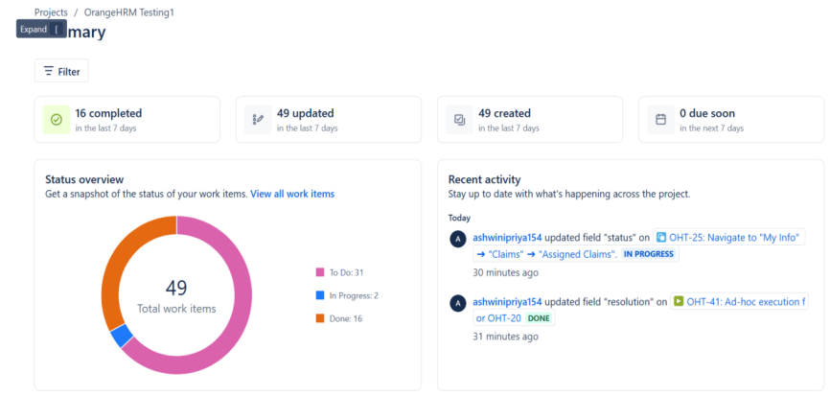
1.Jira – OrangeHRM Test scripts:
User Stories:
• Login Page: OrangeHRM_Login
• Dashboard Page: OrangeHRM_dashboard
• Claim: OrangeHRM_Claim
• Logout
Fig : Summary of test case in JIRA

Slide 6
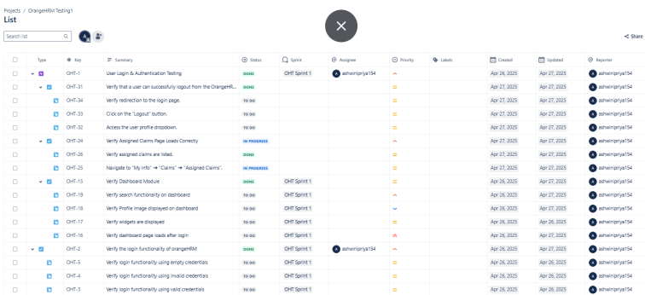
Sample Testcase in JIRA: Verify login functionality with valid credentials.
Issue Types: Epic, Story, Bug, Task, Test Case (via Xray)
Steps :
1. Navigate to login page
2. Enter valid username and password 3. Click "Login" Test Data
Username: admin,
Password: admin123
Expected Results User should be redirected to the dashboard. Actual Result To be captured during execution. Status To be marked after execution (Pass)
Fig : List of testcases

Slide 7
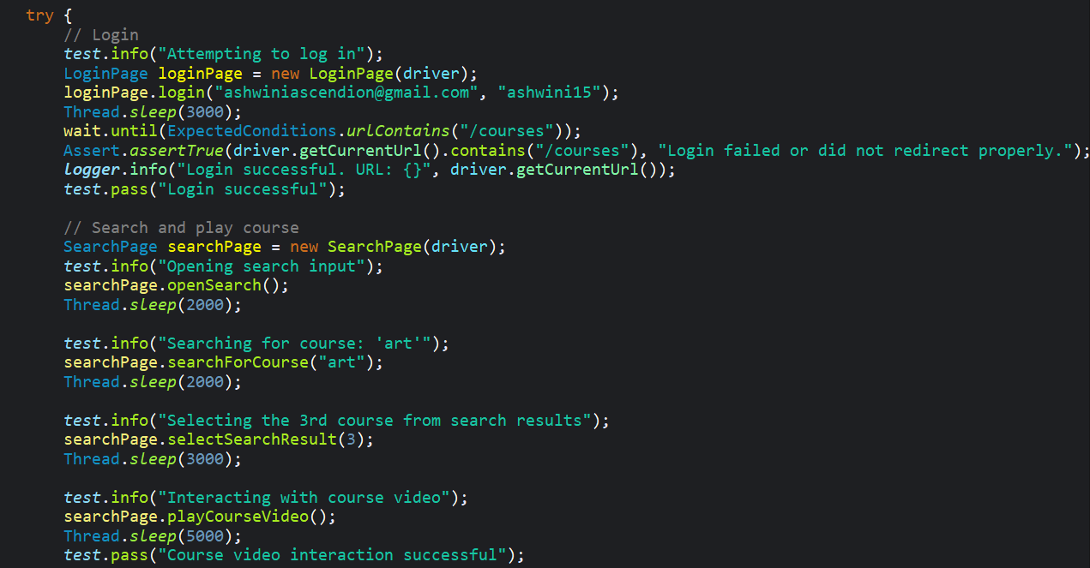
2.Selenium Web UI Test Automation: Khan Academy
START TEST (TestNG Runner)
↓
LAUNCH BROWSER (BaseTest)
↓
OPEN KHAN ACADEMY HOMEPAGE
↓
LOGIN (LoginPage)
↓
SEARCH "Art" (SearchPage)
↓
SELECT RESULT #3
↓
PLAY VIDEO
↓
VIEW PROGRESS PAGE (ProgressPage)
↓
LOGOUT (LogoutPage)
↓
[IF FAILURE] → SCREENSHOT → LOG (Log4j) →
ATTACH REPORT
↓
GENERATE REPORT (ExtentReport)
↓
CLOSE BROWSER
↓
END TEST
CourseAutomationTest.java:

Slide 8
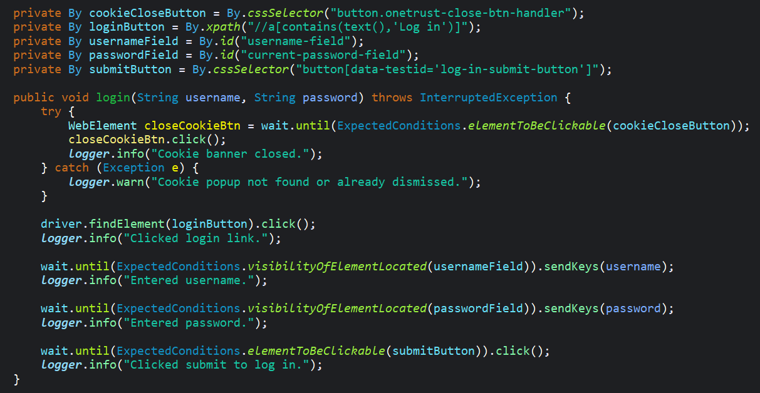
Scenario 1: Login Page
Class: LoginPage.java
✅ Preconditions:
Browser is on Khan Academy homepage.
Cookies pop alert is closed.
Valid credentials are passed.
🔚 Postconditions:
User is redirected to the Courses page.
✔️ Acceptance Criteria:
isLoginSuccessful() or redirection validation method confirms successful login.

Slide 9
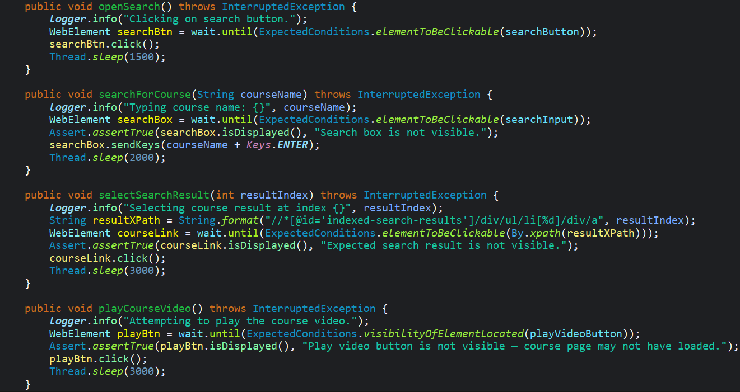
Scenario 2: Course Search
Class: SearchPage.java
✅ Preconditions:
User is logged in.
Search icon is clickable.
🔚 Postconditions:
Search result page loads and 3rd result is clicked.
✔️ Acceptance Criteria:
Course page is loaded with matching course details.

Slide 10
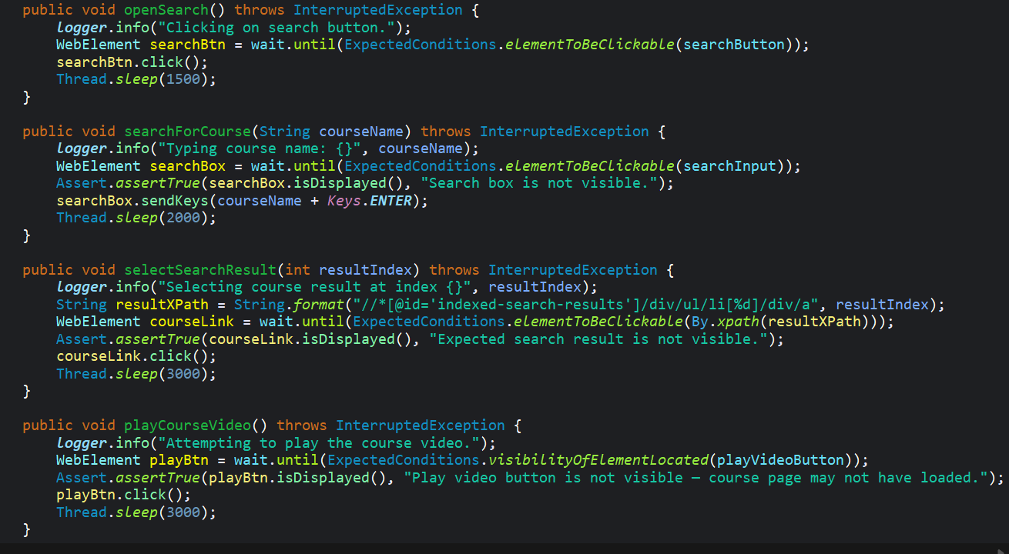
Scenario 3: Play Video
Class: SearchPage.java
✅ Preconditions:
Course page is loaded.
🔚 Postconditions:
Video player starts playing.
✔️ Acceptance Criteria:
Video player becomes visible and isDisplayed() returns true.
Optional: Thread.sleep() to simulate play duration.

Slide 11
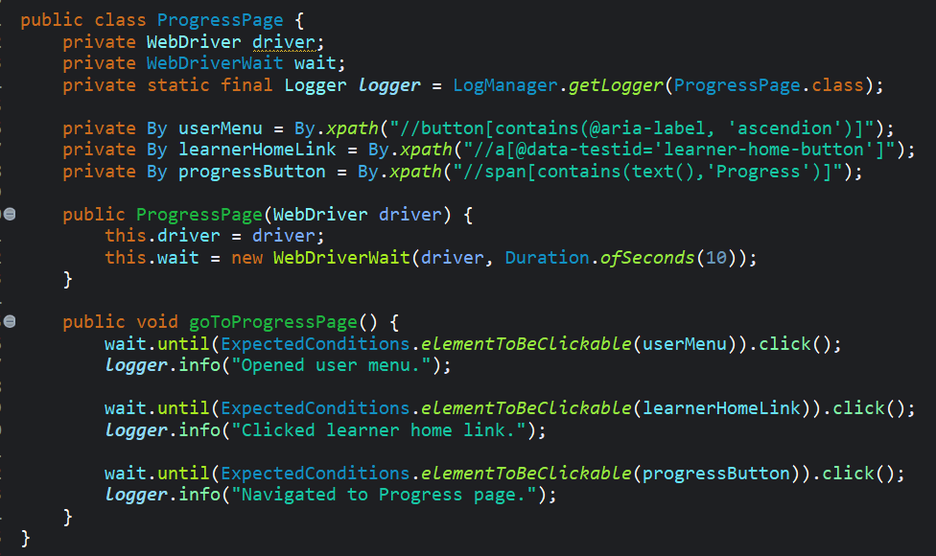
Scenario 4: View Progress
Class: ProgressPage.java
✅ Preconditions:
User is logged in.
🔚 Postconditions:
Progress dashboard is loaded.
✔️ Acceptance Criteria:
Page elements specific to progress tracking are visible.
isProgressPageVisible() returns true.

Slide 12
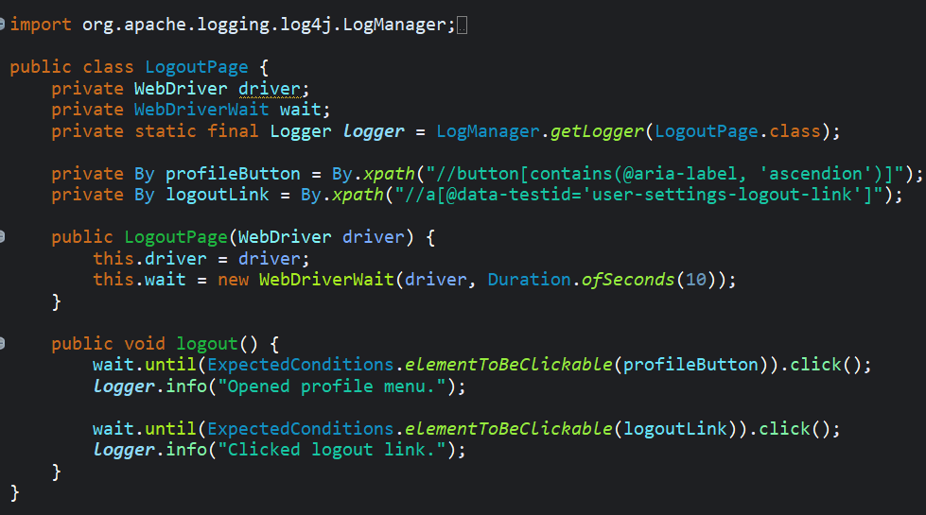
Scenario 5: Logout
Class: LogoutPage.java
✅ Preconditions:
User is on any page and logged in.
🔚 Postconditions:
User is logged out and redirected to homepage or login screen.
✔️ Acceptance Criteria:
isLoggedOut() returns true.
UI indicates user is logged out (e.g., login button visible).

Slide 13
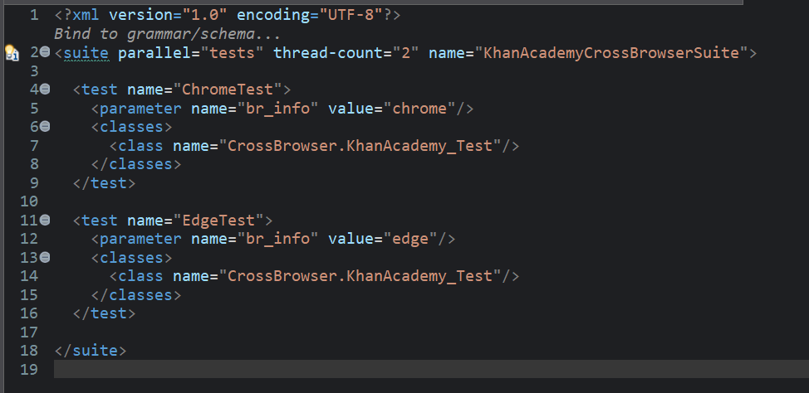
CROSS BROWSER:
Running Login test case in parallel across multiple browsers (Chrome and Edge) to ensure cross-browser compatibility.

Slide 14
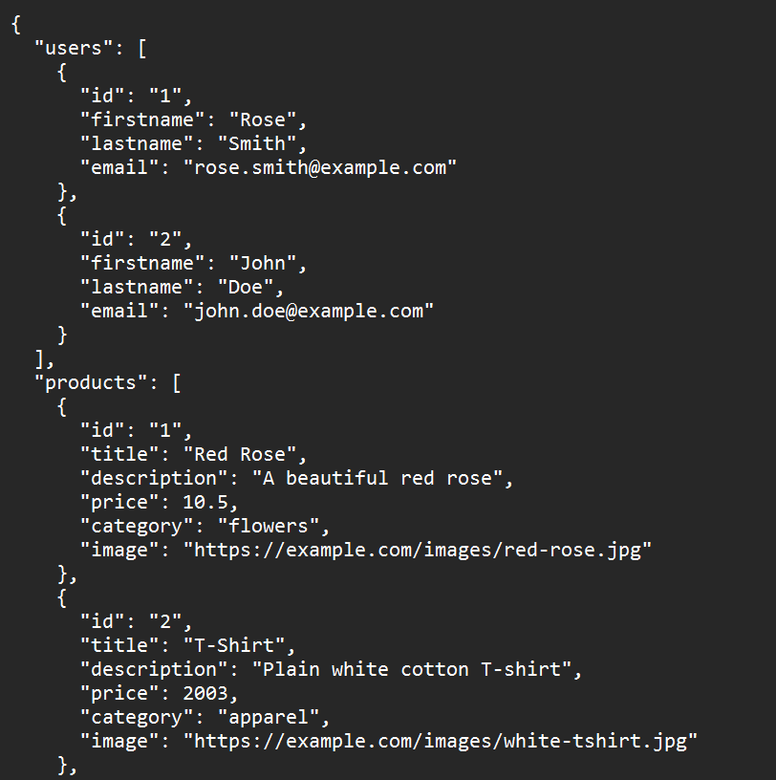
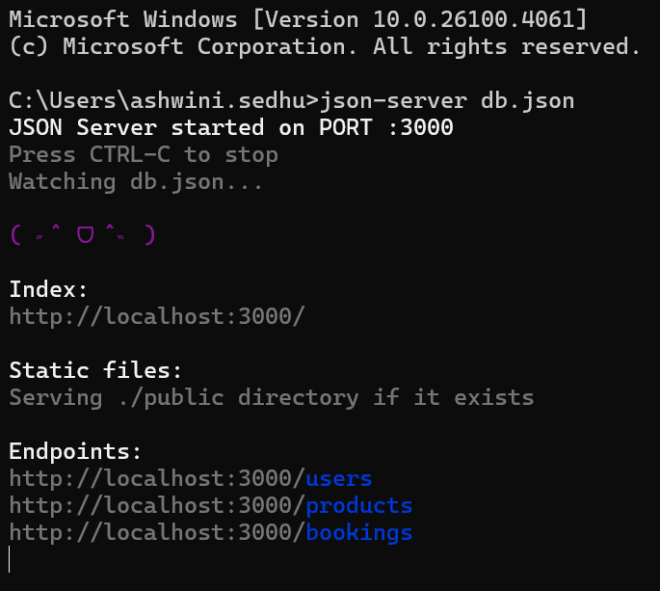
3.API Automation with Postman and Newman:
1. Set Up Mock API
Create a db.json file with mock data
Start JSON Server → http://localhost:3000
db.json

Slide 15
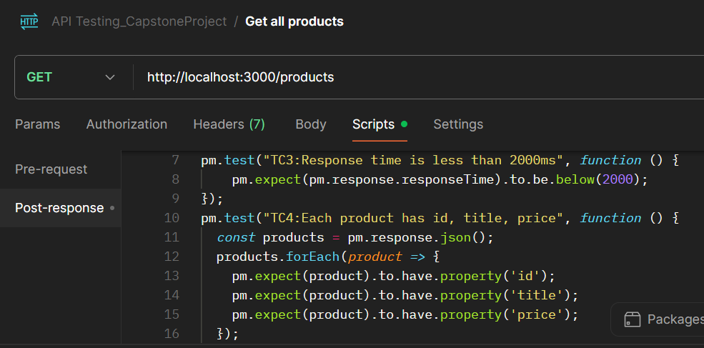
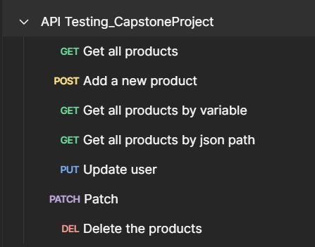
3.API Automation with Postman and Newman:
2. Design Tests in Postman
Create collections with API requests
Write test scripts using JavaScript
Use variables for flexibility

Slide 16
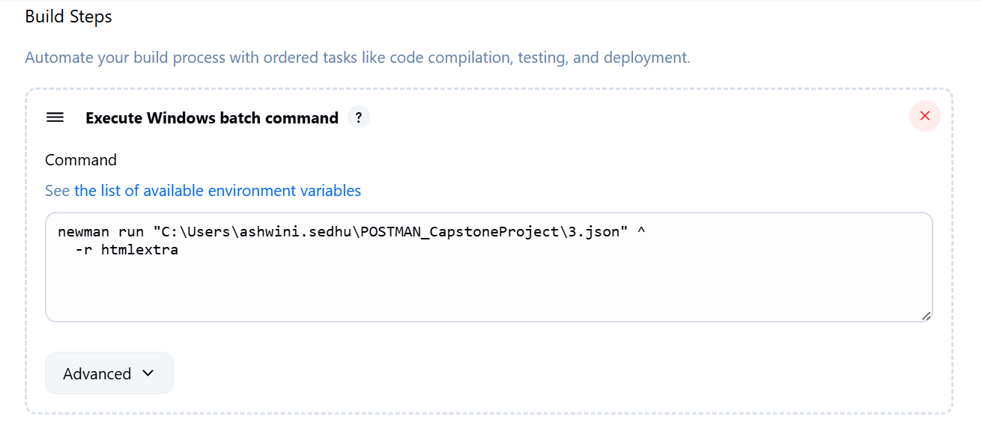
3.API Automation with Postman and Newman:
3. Automate with Newman using JENKINS
Run Postman collections using csv
Generate HTML using newman in Jenkins
Integrate into CI/CD pipeline

Slide 17
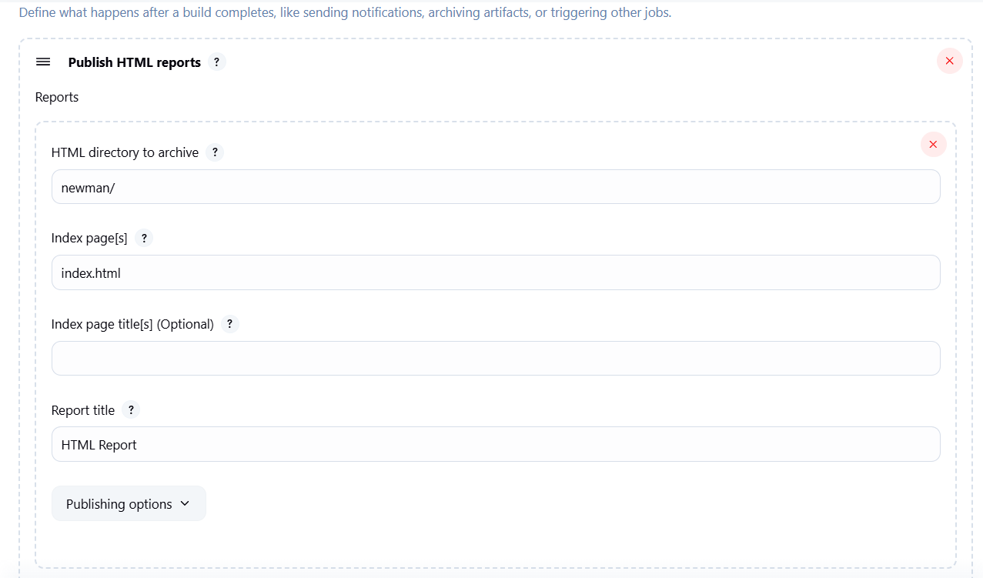
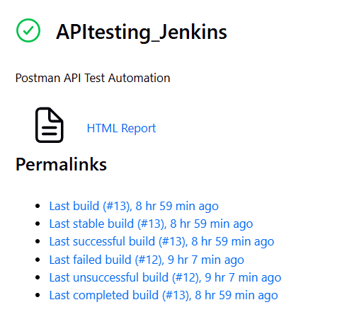
3.API Automation with Postman and Newman using Jenkins:

Slide 18
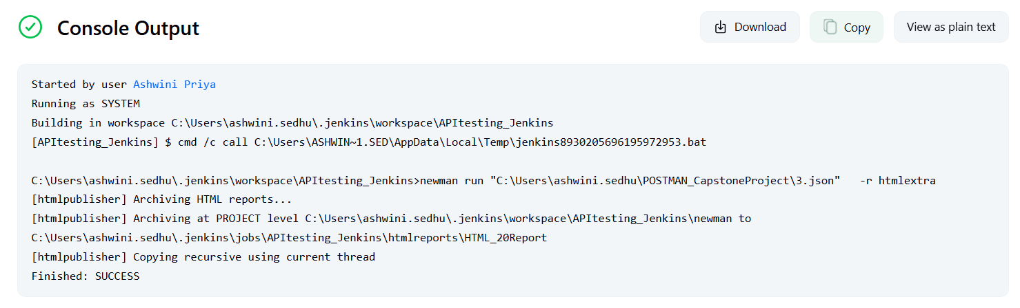
3.API Automation with Postman and Newman using Jenkins:

Slide 19
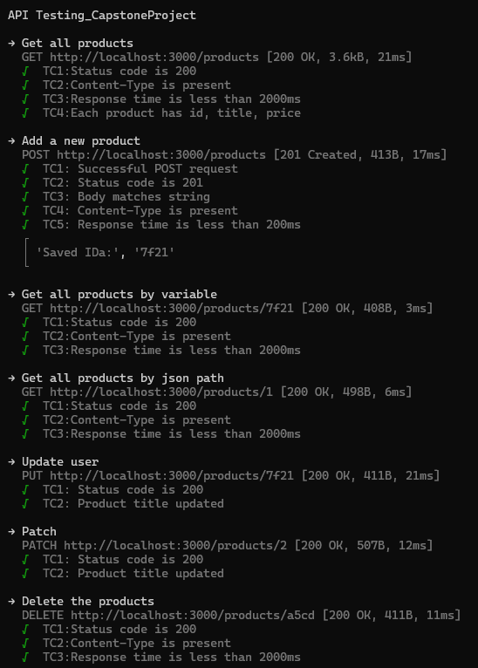
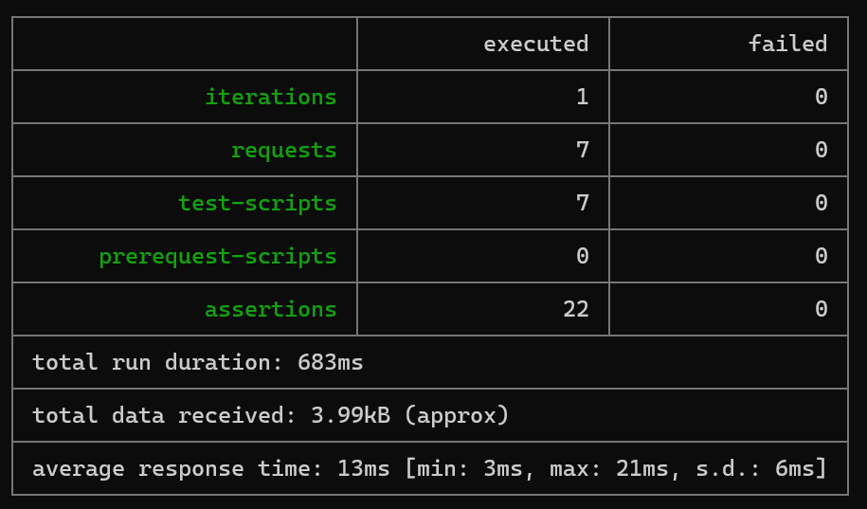

Slide 20
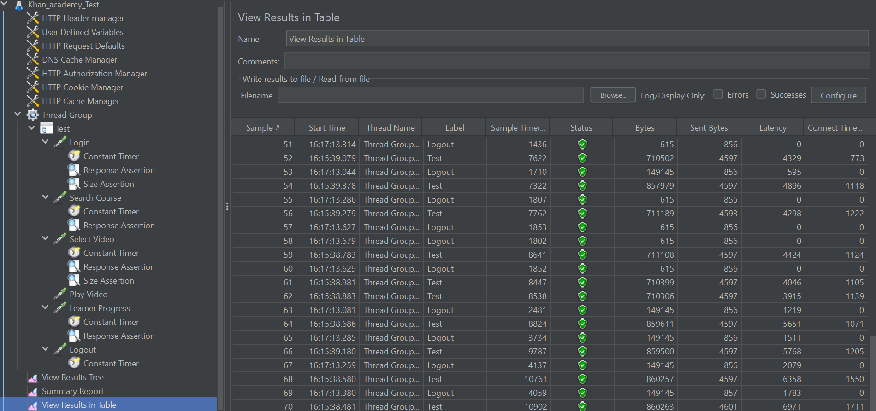
JMeter Test Execution: Khan Academy

Slide 21

Conclusion :
Built and executed end-to-end test automation using Selenium, TestNG, and Log4j.
Managed test cases with JIRA + Xray and integrated Postman + Newman into Jenkins.
Performed API and performance testing using industry tools like JMeter.
Practiced Agile workflows and ensured cross-browser compatibility.
Gained strong hands-on experience, ready for real-world QA Automation roles.

Slide 22
Reference Links:
🔗 Web Application
Khan Academy - https://www.khanacademy.org/
🔗 API Base URL
POSTMAN [Local Host] - https://lively-astronaut-250751.postman.co/workspace/ProjectQ3team~25441188-214d-48e8-9404-95ee882aa8fc/collection/39843655-bb350d87-c294-4fff-b50b-87aeeb65f59d?action=share&creator=39843655
🔗 GitHub Repository
https://github.com/AshwiniPriyaSedhu/CAPSTONE_Ascendion_WEB_API_MAY2025/
🔗 JIRA or Documentation (Optional)
Jira | Issue & Project Tracking Software | Atlassian

Slide 23
Any question?

Slide 24
Thank You

